Slide 1
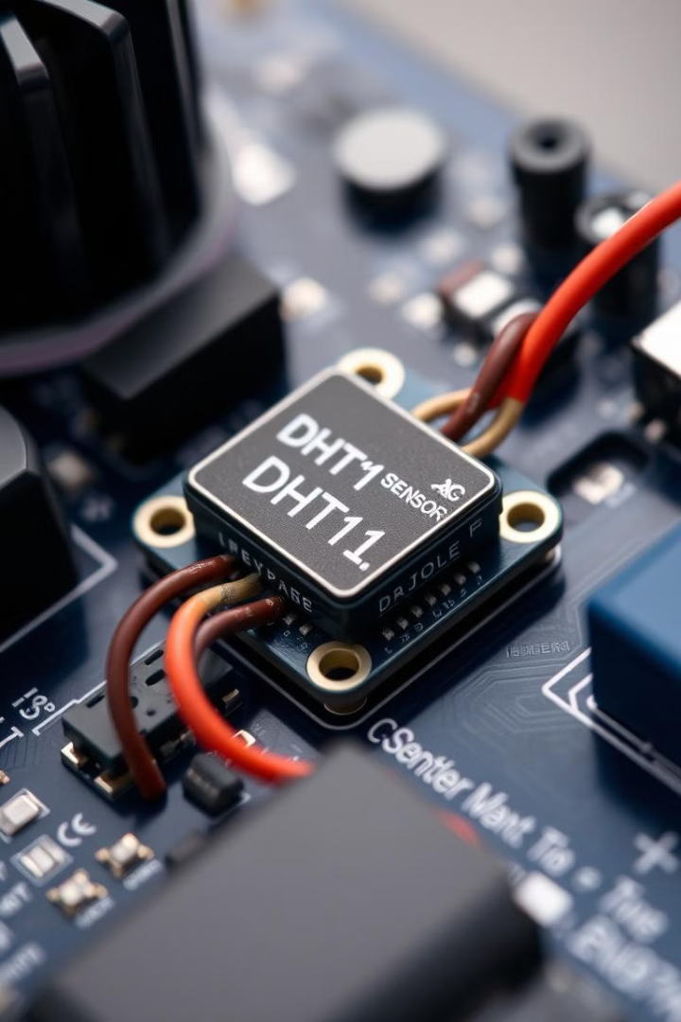

Introduction to DHT11: Temperature and Humidity Sensor
The DHT11 is a versatile and affordable temperature and humidity sensor widely used in various applications. Understanding its workings can enable efficient monitoring of environmental conditions in diverse contexts.
by swaraj upgrad

Slide 2
DHT11 Specifications and Features
Temperature
Humidity
Other
Range: 0°C to 50°C
Range: 20% to 90% RH
Voltage: 3.5V to 5.5V
Accuracy: ±2°C
Accuracy: ±5% RH
Sampling Rate: 1 Hz

Slide 3
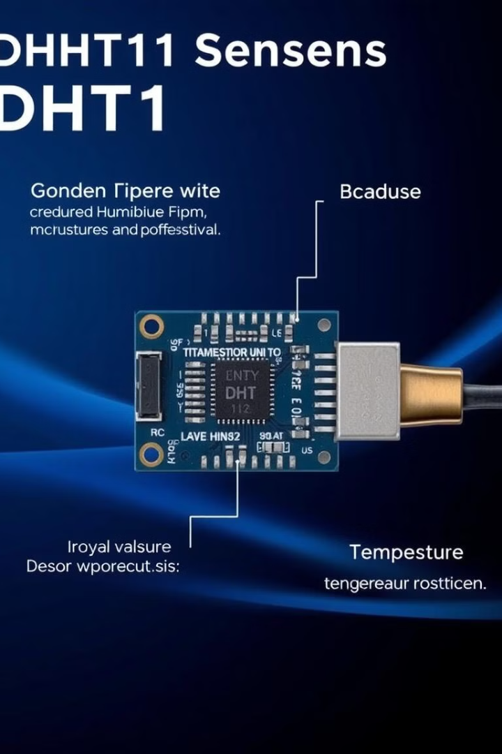




DHT11 Internal Structure
Humidity Sensor
Temperature Sensor
Integrated Circuit
Capacitive humidity sensor
Converts analog to digital
NTC Thermistor
Single-wire Communication
Serial data transmission

Slide 4
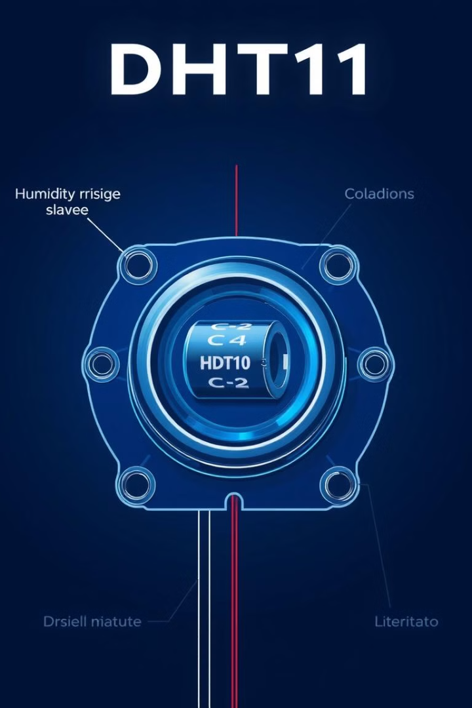



Working Principle: Humidity Sensing
Capacitance change
Humidity levels affect sensor's capacitance
Digital Conversion
Internal IC converts capacitance into a digital value
Oscillator Measurement
IC uses an oscillator to measure the capacitance

Slide 5

Working Principle: Temperature Sensing
Resistance Change
1
NTC thermistor's resistance varies with temperature
2
Voltage Divider Circuit
IC measures resistance using a voltage divider
Digital Conversion
3
IC converts voltage into a digital temperature value

Slide 6
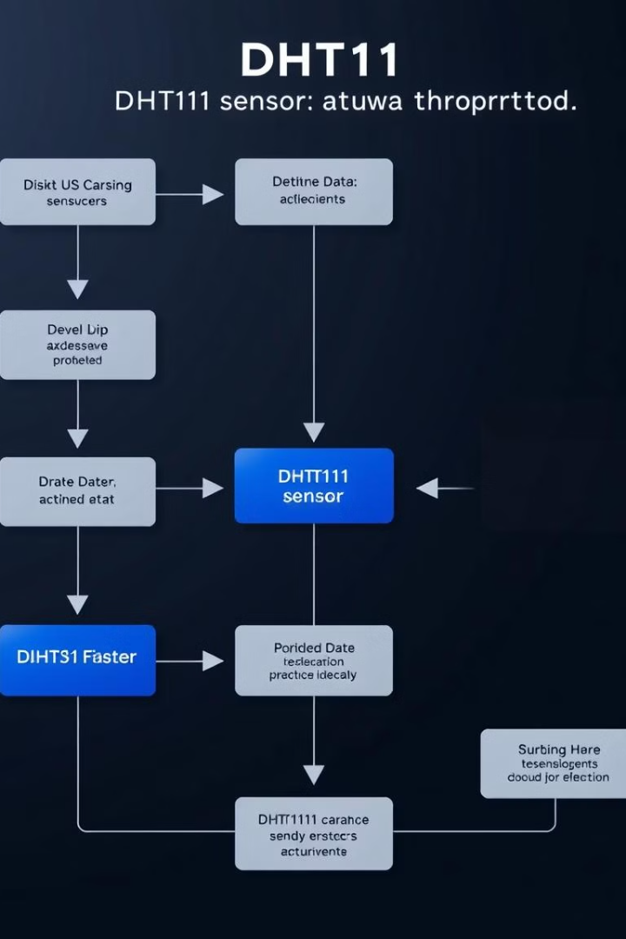
DHT11 Data Transmission Protocol
Start Signal
MCU initializes communication
Response Signal
DHT11 confirms readiness
Data Transmission
40-bit data packet sent serially
Bit Transmission
Each bit encoded with pulse duration

Slide 7

Applications of DHT11
Home Weather Stations
Agricultural Monitoring
Monitoring indoor temperature and humidity
Measuring environmental conditions
HVAC Systems
Data Loggers
Controlling temperature and humidity
Recording temperature and humidity data

Slide 8
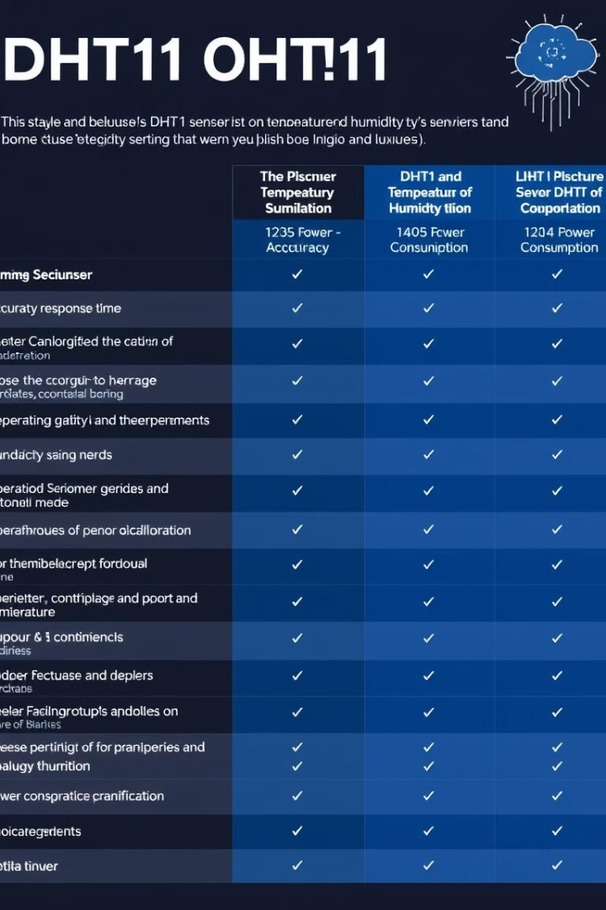
Limitations and Alternatives
1
Limited temperature and humidity range
2
Lower accuracy than more expensive sensors
3
Slower sampling rate
4
Susceptible to noise and interference

